Slide 1
DataBase with PostgreSQL

Slide 2
make a PostGreSQL DataBase with 5-10 tables, > 50 rows of data about a BookShop or a Library
books, lot of books, ...
could be original – database could be about something else if it somehow related to book
data should not be as easy as 1, 2, C.

Slide 3
get inspiration from a Web site and try to guess what kind of database it is behind …

Slide 4
autovit.ro/
businessmagazin.ro: afaceri/tranzactie-record-pe-online-site-ul-autovit-ro-a-fost-vandut-cu-5-mil-euro

Slide 5
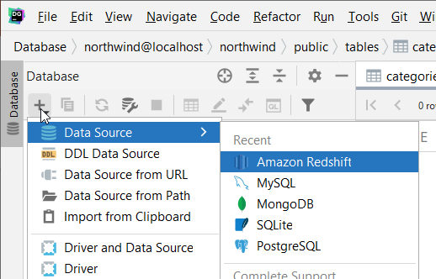
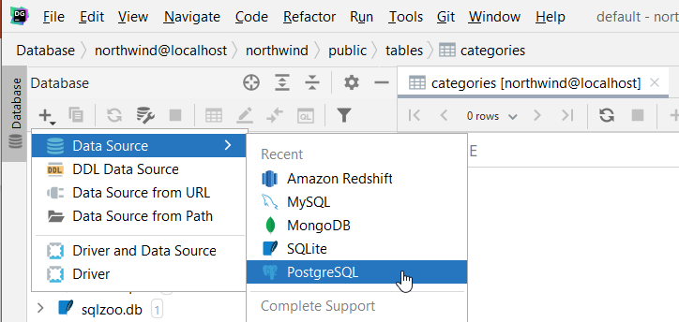
presented with DataGrip

Slide 6
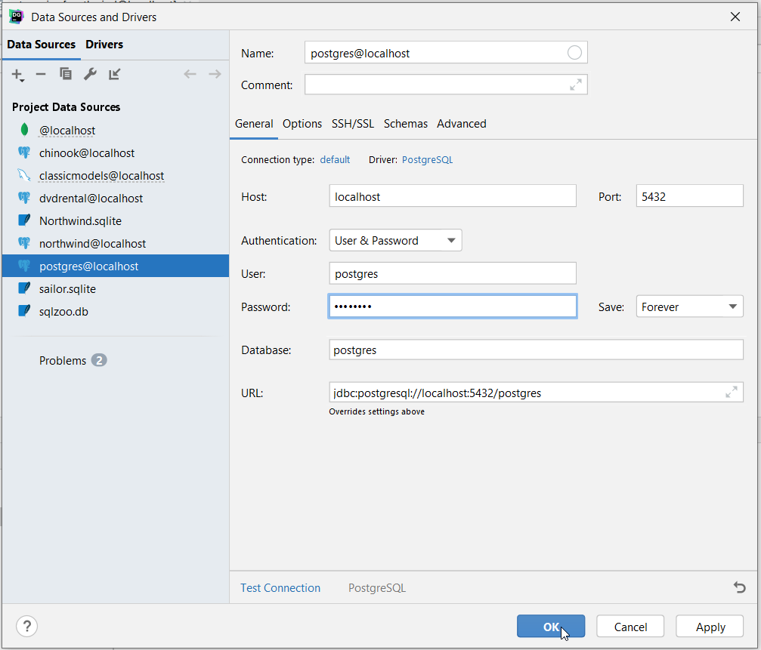
in postgres (system) DataBase

Slide 7
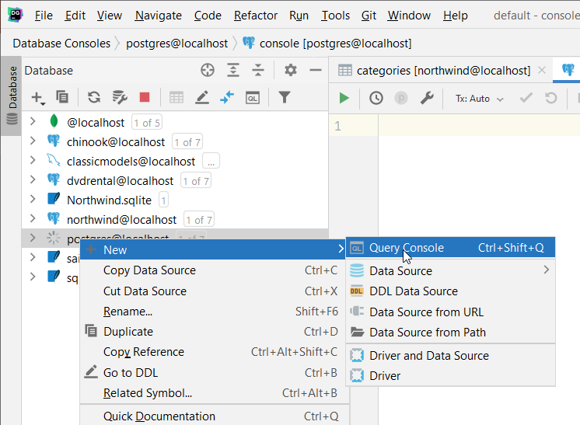
Query Console

Slide 8
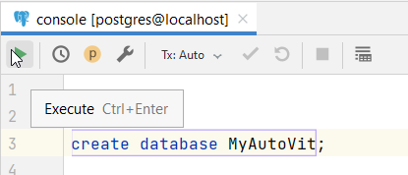
CREATE DATABASE MyAutoVit

Slide 9
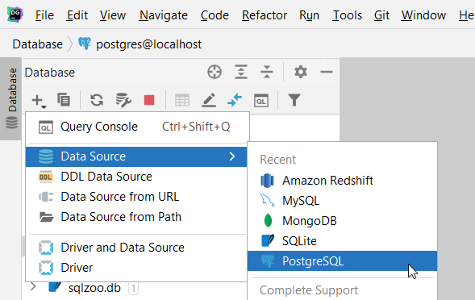
in MyAutoVit DataBase

Slide 10
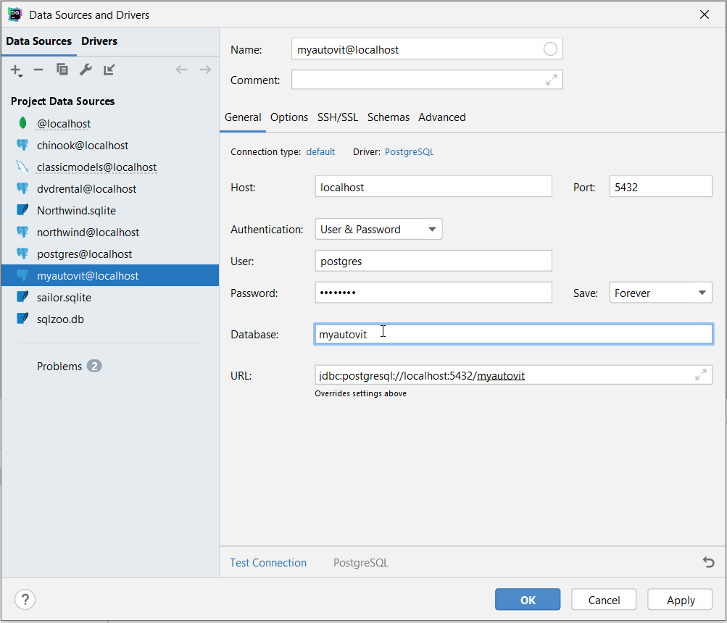
in MyAutoVit DataBase

Slide 11
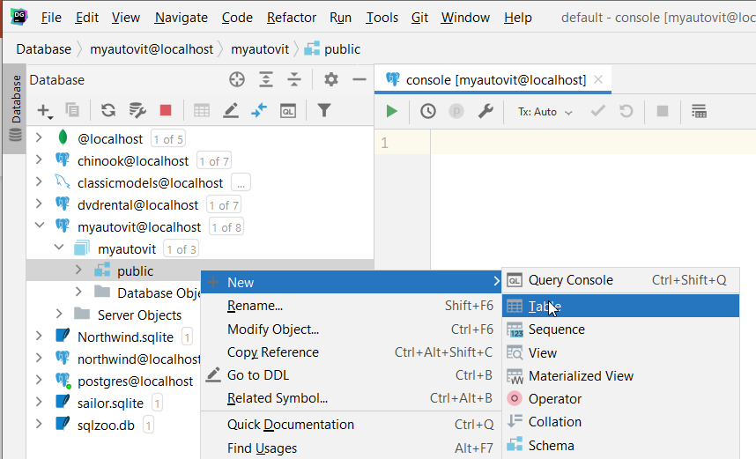

Slide 12
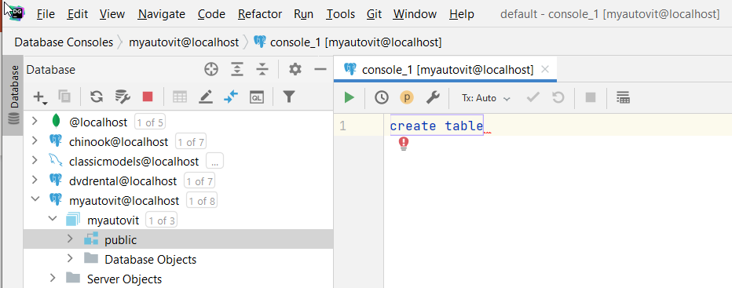

Slide 13
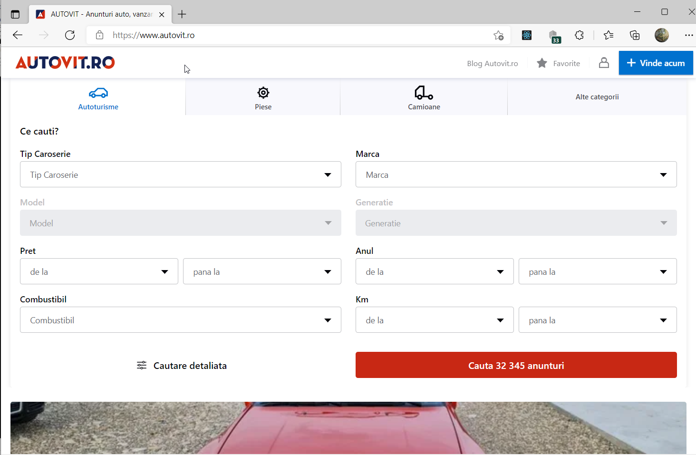

Slide 14
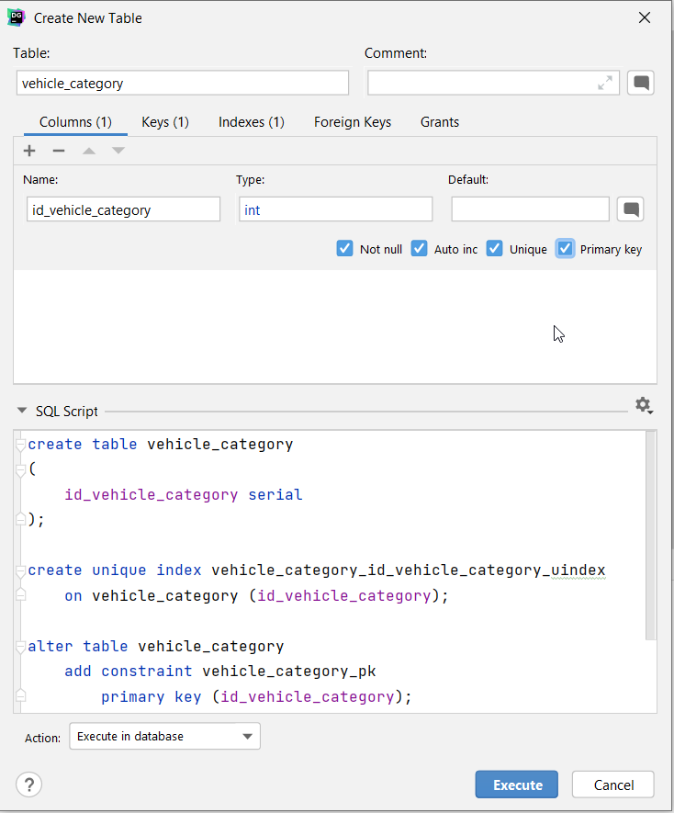
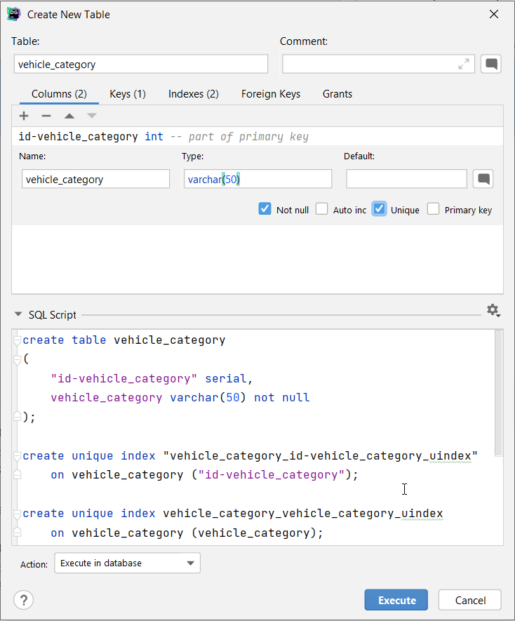

Slide 15
INSERT INTO vehicle_category (vehicle_category)
VALUES
('Cabrio'),('Combi'),('Compacta'),('Coupe'),
('Masina de oras'),('Masina mica'),('Monovolum'),('Sedan'),('SUV')

Slide 16
CREATE TABLE manufacturer (
id_manufacturer serial,
manufacturer varchar(50) not null );
CREATE UNIQUE INDEX manufacturer_id_manufacturer_uindex
ON manufacturer (id_manufacturer);
CREATE UNIQUE INDEX manufacturer_manufacturer_uindex
ON manufacturer (manufacturer);
ALTER TABLE manufacturer
ADD CONSTRAINT manufacturer_pk
PRIMARY KEY (id_manufacturer);

Slide 17
INSERT INTO manufacturer (manufacturer)
VALUES
('Abarth'),
('Acura'),
('Aixam'),
('Alfa Romeo'),
('Altul'),
('Aro'),
('Aston Martin'),
('Audi'),
('Austin'),
('Bentley'),
('BMW'),
('Bugatti'),
('Buick'),
('Cadillac'),
('Chatenet'),
('Chevrolet'),
('Chrysler'),
('Citroën'),
('Comarth'),
('Cupra'),
('Dacia'),
('Daewoo'),
('Daihatsu'),
('De Lorean')

Slide 18
CREATE TABLE model (
id_model serial,
model varchar(50),
id_manufacturer int );
CREATE UNIQUE INDEX model_id_model_uindex
ON model (id_model);
CREATE UNIQUE INDEX model_model_uindex
ON model (model, CAST(id_manufacturer AS varchar(10)));
ALTER TABLE model
ADD CONSTRAINT model_pk
PRIMARY KEY (id_model);

Slide 19
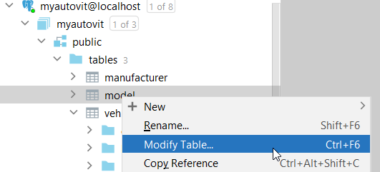
ALTER TABLE model

Slide 20
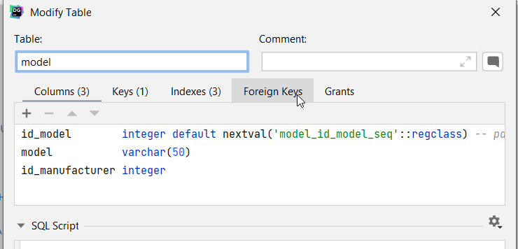
Foreign Keys

Slide 21
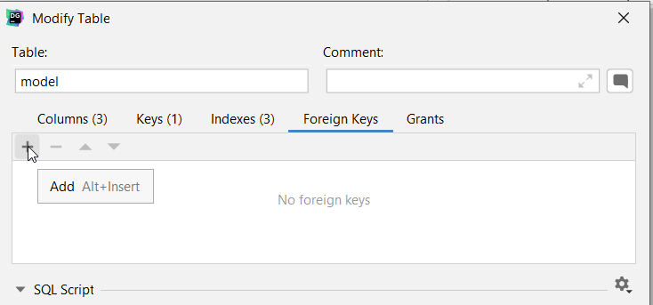
Add Foreign Keys

Slide 22
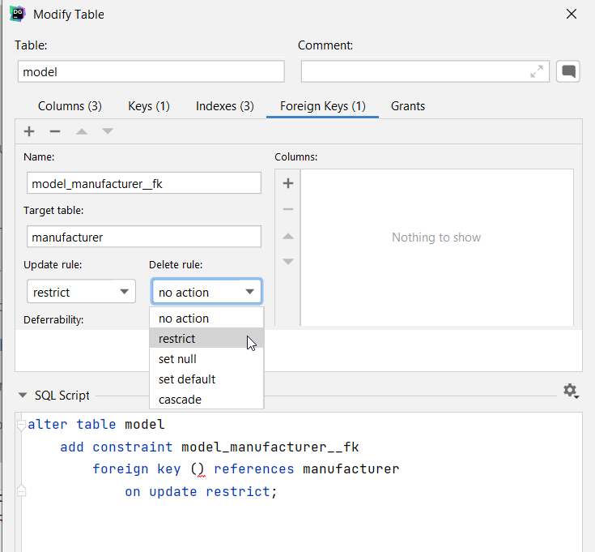
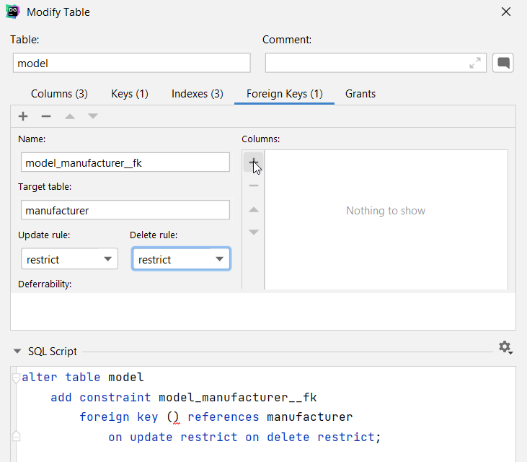

Slide 23
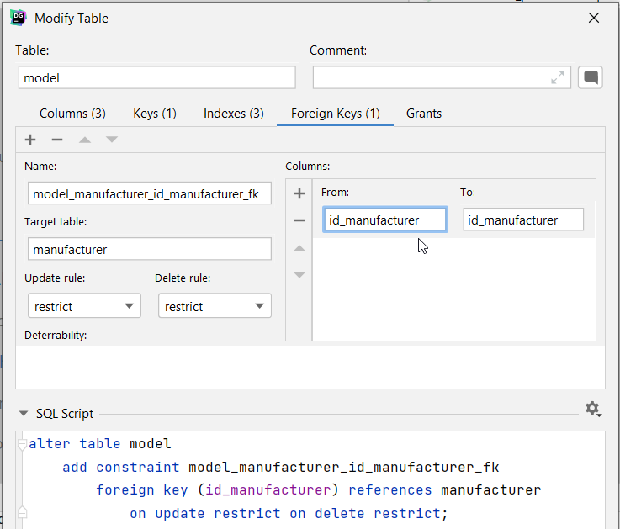
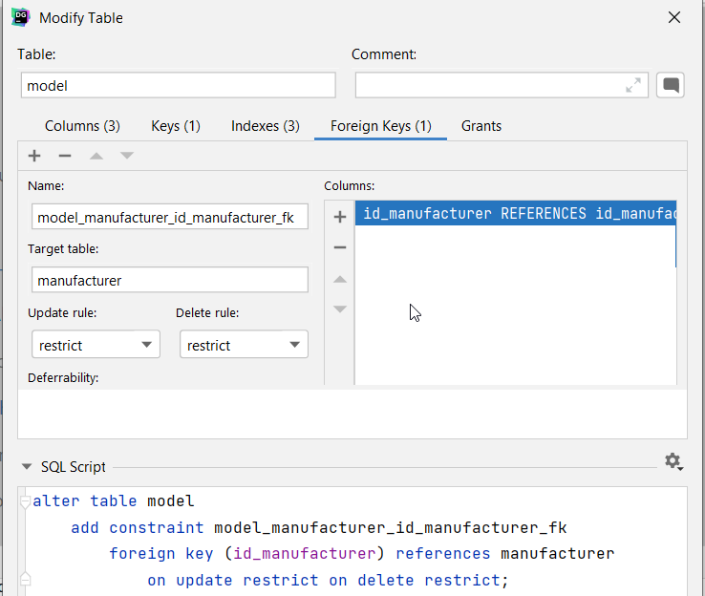
id_manufacturer FK from model REFERENCES id_manufacturer PK of manufacturer

Slide 24
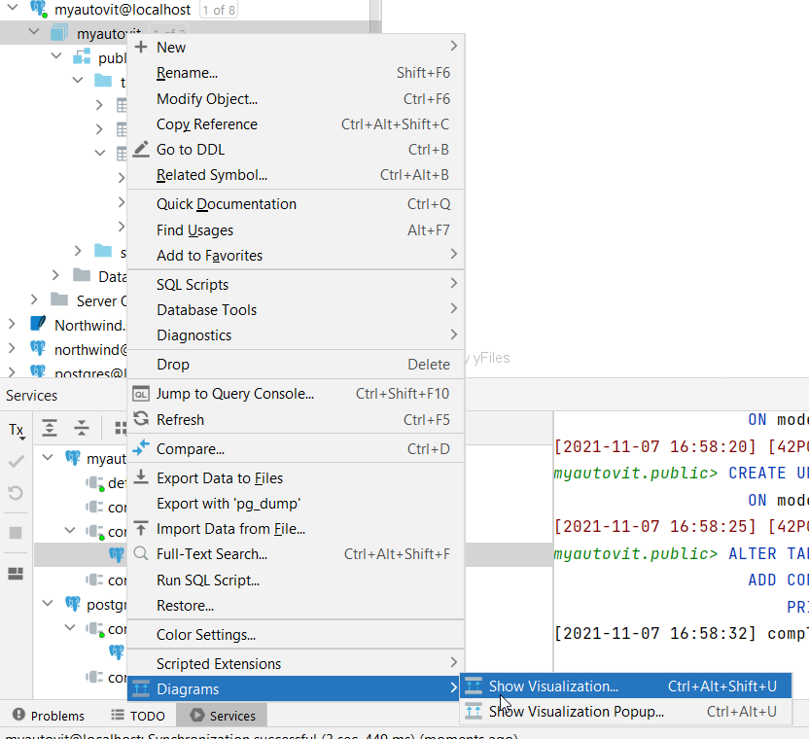

Slide 25
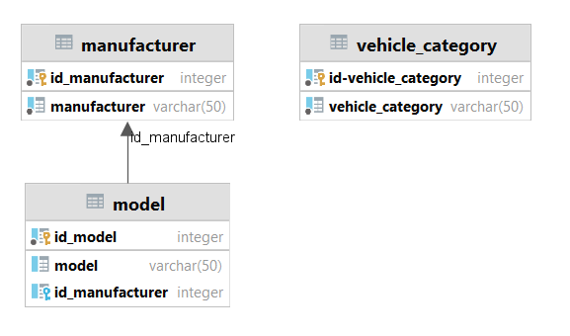

Slide 26
INSERT INTO model (id_manufacturer, model)
VALUES
(21, '1100'),
(21, '1300'),
(21, '1400'),
(21, '1410'),
(21, 'Altul'),
(21, 'Dokker'),
(21, 'Duster'),
(21, 'Lodgy'),
(21, 'Logan'),
(21, 'Logan Stepway'),
(21, 'Logan Van'),
(21, 'Nova'),
(21, 'Pick Up'),
(21, 'Sandero'),
(21, 'Sandero Stepway'),
(21, 'Solenza'),
(21, 'Super Nova')

Slide 27
SELECT * FROM manufacturer LEFT OUTER JOIN model m ON manufacturer.id_manufacturer = m.id_manufacturer

Slide 28
create table car_for_sale (
id_car_for_sale serial constraint car_for_sale_pk primary key,
id_model integer not null
constraint car_for_sale_model_id_model_fk
references model on update restrict on delete restrict,
id_vehicle_category integer
constraint car_for_sale___fk2
references vehicle_category on update restrict on delete restrict,
"asking_Price" integer not null,
"current_Mileage" integer,
"date_Acquired" date,
. . .

Slide 29
create table car_for_sale (
. . .
"date_Acquired" date,
"registration_Year" integer,
description text,
constraint car_for_sale_check
check (("asking_Price" > 0) AND ("current_Mileage" >= 0))
);
alter table car_for_sale owner to postgres;
create unique index car_for_sale_id_car_for_sale_uindex
on car_for_sale (id_car_for_sale);

Slide 30
Second hand Dacia Logan - 2 500 EUR, 45 963 km, 2006 - autovit.ro

Slide 31
SELECT * FROM car_for_sale
JOIN model m on m.id_model = car_for_sale.id_model
JOIN vehicle_category vc on car_for_sale.id_vehicle_category = vc.id_vehicle_category

Slide 32
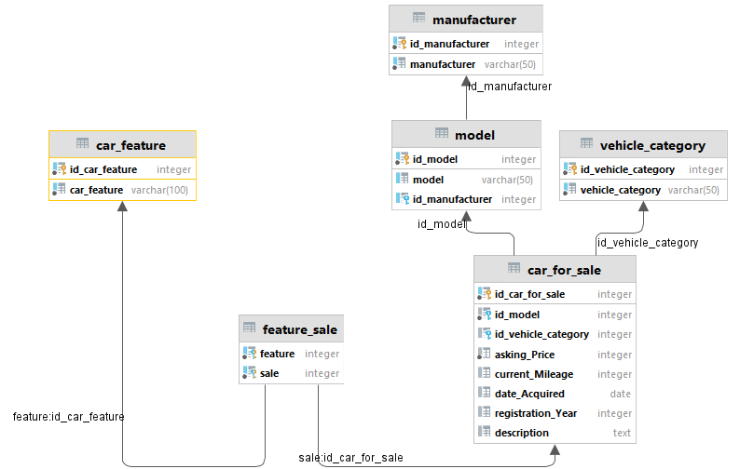

Slide 33
BackUp DataBase
pg_dump -U postgres -W -F p myautovit > myautovit20211108.sql

Slide 34
CREATE DATABASE mynewautovit

Slide 35
ReStore DataBase
psql -U postgres -d mynewautovit < myautovit20211108.sql

Slide 36
pg_dump
command line

Slide 37
pg_dump
extract PostgreSQL database into script file or other archive file format
pg_dump [connection-option...] [option...] [dbname]
utility for backing up PostgreSQL database; makes consistent backups even if database is being used concurrently (does not block other users accessing database (readers or writers))
only dumps single database
to back up entire cluster, or global objects that are common to all databases use pg_dumpall

Slide 38
pg_dump [connection-option...] [option...] [dbname]
dbname: specifies name of database to be dumped
-a or --data-only: dump only data, not schema (data definitions)
-b or –blobs: include large objects in dump; this is default behavior
-f file or --file=file: send output to specified file; can be omitted in which case standard output is used

Slide 39
-F format or --format=format: selects format of output; can be one of following:
  p or plain: output plain-text SQL script file (the default)
  c or custom:
  d or directory: output directory-format archive
  t or tar: output tar-format archive

Slide 40
-O or --no-owner: do not output commands to set ownership of objects to match original database; by default, pg_dump issues ALTER OWNER or SET SESSION AUTHORIZATION statements to set ownership of created database objects; to make script that can be restored by any user, but will give that user ownership of all objects
-s or --schema-only: dump only object definitions (schema), not data
-v or --verbose

Slide 41
-d dbname or --dbname=dbname: specifies database to connect to
  can be connection string
-h host or --host=host
-p port or --port=port
-U username or --username=username

Slide 42
-w or --no-password: never issue password prompt
  if server requires password authentication and is not available by other means connection attempt will fail
  useful in batch jobs and scripts where no user is present to enter password
-W or –password: force pg_dump to prompt for password before connecting to database
  accept password, do not show characters from password (not even *)

Slide 43
psql
command line tool

Slide 44
psql
psql [option...] [dbname [username]]
terminal-based command line front-end to PostgreSQL
enables you to type in queries interactively, issue them to PostgreSQL, and see query results
alternatively, input can be from script file or from command line arguments
in addition to Structured Query Language SQL statements, provides a number of meta-commands and various shell-like features to facilitate writing scripts and automating tasks

Slide 45
-c command or --command=command: specifies that psql is to execute given command string
  command must be either
    command string that is completely parsable by server (i.e., it contains no psql-specific features)
    single backslash command
  cannot mix SQL and psql meta-commands
-f filename or --file=filename: read commands from file, rather than standard input

Slide 46
-U username or --username=username: connect to database as user username instead of default
-d dbname or --dbname=dbname: specifies name of database to connect; equivalent to specifying dbname as first non-option argument on command line
  dbname can be connection string

Slide 47
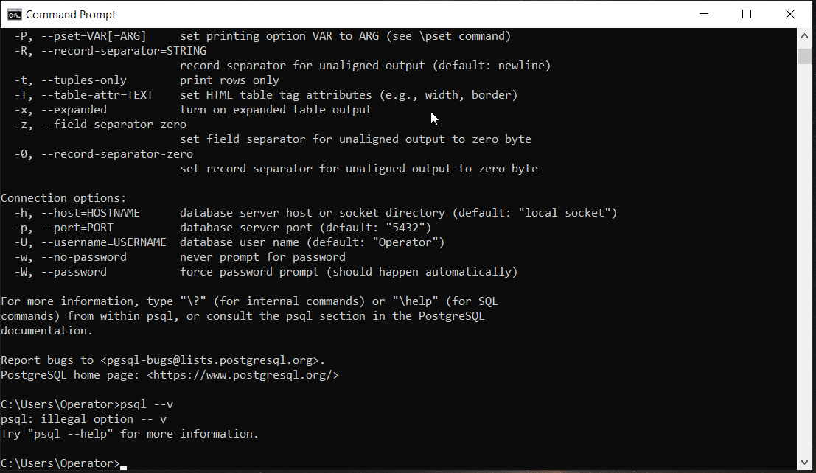
output of psql --help

Slide 48
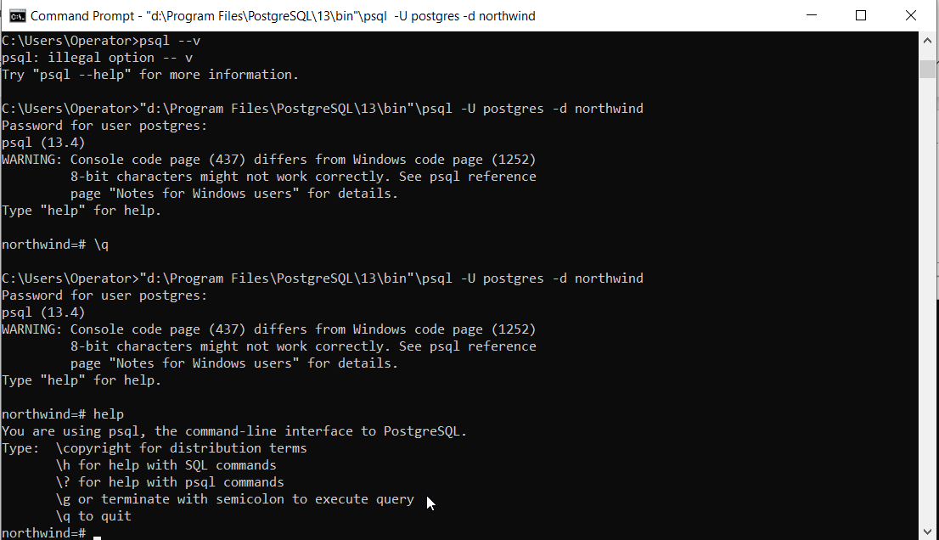
psql help

Slide 49
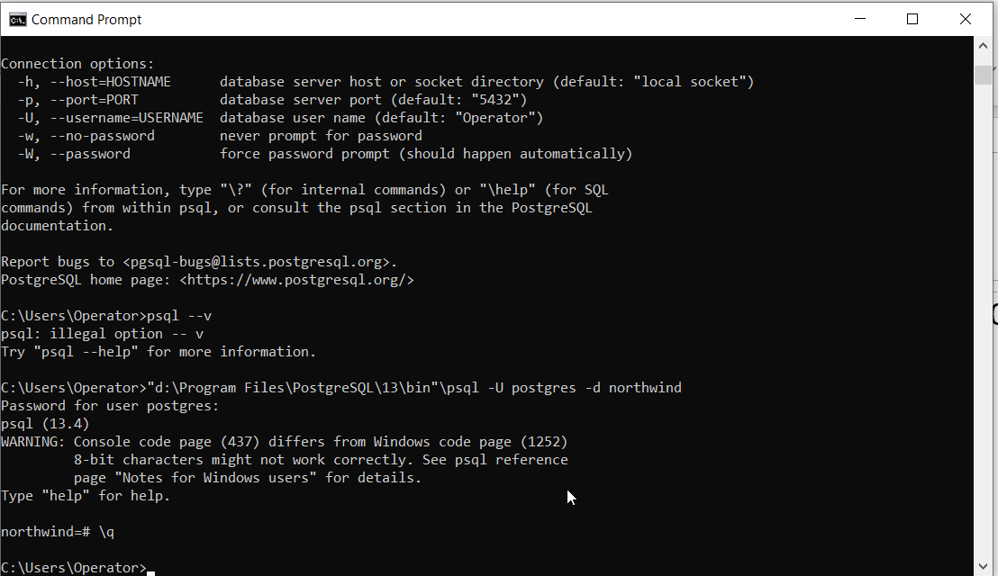
psql quit

Slide 50
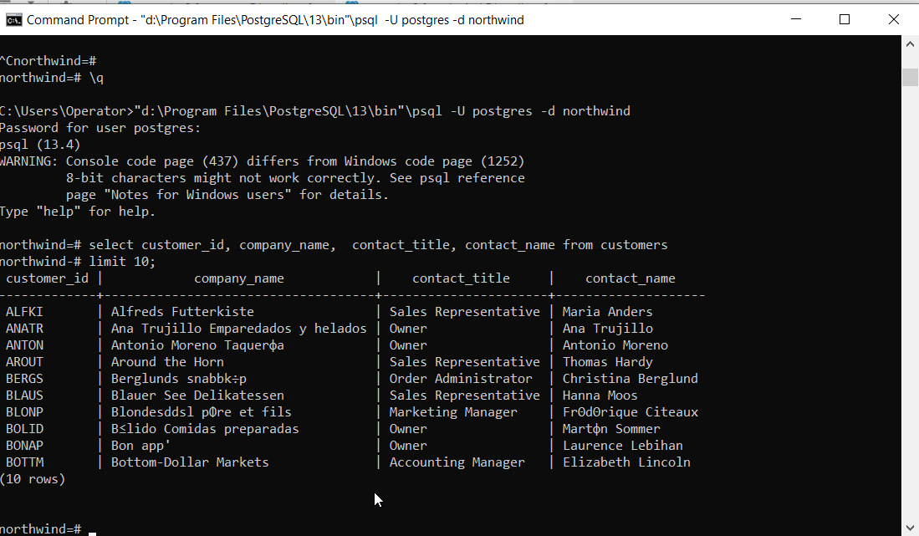
select

Slide 51
Structured Query Language
PostGreSQL specific
LIMIT is optional clause of SELECT statement that constrains number of rows returned by query
  SELECT select_list FROM table_name ORDER BY sort_expression
  LIMIT row_count
  OFFSET row_to_skip;
returns row_count rows generated by query
in case you want to skip number of rows before returning row_count rows, you use OFFSET clause placed after LIMIT clause
LIMIT and OFFSET are last clauses in SQL statement

Slide 52
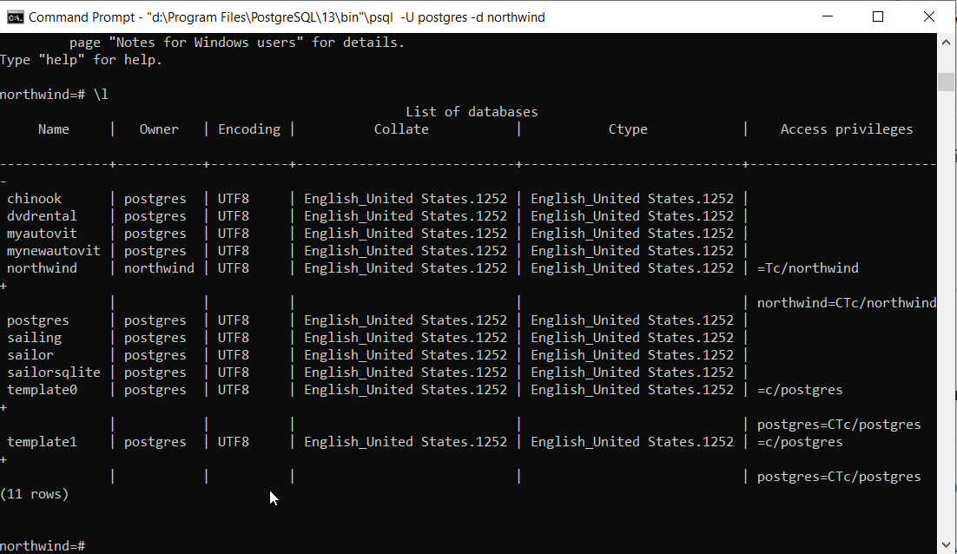
list DataBases

Slide 53
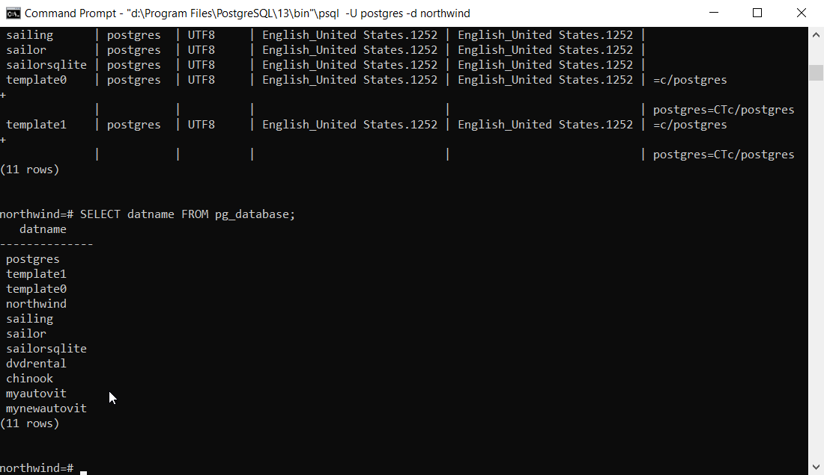
list DataBases
SELECT datname FROM pg_database

Slide 54
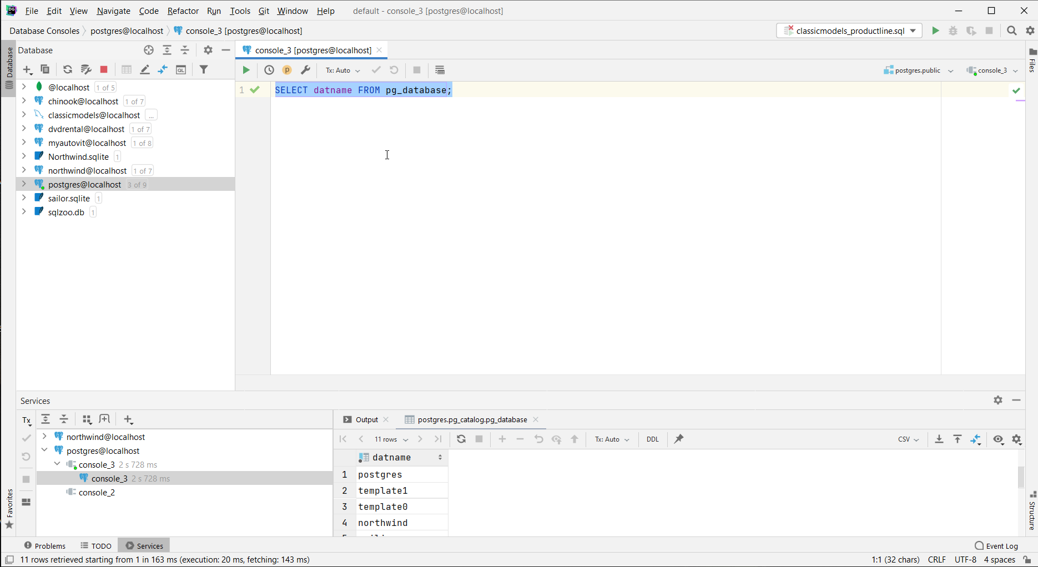

Slide 55
server database schema

Slide 56
Template databases
when database is created, it is cloned from template database called template1
template database contains set of tables, views, and functions, which is used to model relation between user defined database objects; part of system catalog schema called pg_catalog
template0: it is a safeguard or version database

Slide 57
Schema
is very close to namespace concept in object-oriented languages
used to organize database objects, functionality, security access, or to eliminate name collision

Slide 58
User DataBases
can have as many databases as one wants in database cluster
client connection to PostgreSQL server can access only the data in a single database that is specified in connection string; that means that data is not shared between databases, unless postgres foreign data wrapper or dblink extensions are used
every database in cluster has owner and set of associated permissions to control actions allowed for particular role

Slide 59
Roles
belong to PostgreSQL server cluster and not to certain database
can either be a database user or a database group
role concept subsumes concepts of users and groups
CREATE USER is equivalent to CREATE ROLE with LOGIN option
CREATE GROUP is equivalent to CREATE ROLE with NOLOGIN option

Slide 60
roles attributes
Super user: can bypass all permission checks except login attribute
Login: can be used by client to connect to database
Create database: can create databases
Initiating replication: can be used for streaming replication
Password: can be used with md5 authentication method; can be encrypted; password expiration can be controlled
Connection limit: specifies number of concurrent connections that user can initiate
Inherit: will inherit privileges assigned to roles that it is a member of

Slide 61
Tablespace
defined storage location for a database or database objects

Slide 62
database could be considered as container for database schema
database must contain at least one schema
schema is used to organize database objects in a manner similar to namespaces in programing languages
schema contains all database named objects: tables, views, functions, aggregates, indexes, sequences, triggers, data types, domains, ranges
inherited from template databases, by default, there is a schema called public and all users can access this schema implicitly

Slide 63
Setting
PostgreSQL provides SET and SHOW commands to change and inspect value of a setting parameters; used to change setting parameters in superuser and user context
typically, changing value of setting parameter in postgresql.conf file makes the effect global

Slide 65
Schema
contains all database named objects: tables, views, functions, aggregates, indexes, sequences, triggers, data types, domains, ranges; object names can be reused in different schema without conflict
by default, there is a schema called public in template databases -> all newly created databases also contain this schema; all users, by default, can access this schema implicitly (inherited from template databases)
to access object, specify schema_name.object_name dot separated (.)

Slide 66
developers prefer to use unqualified object name, only object name, without schema
search_path setting composed of schemas that are used by server to search for object
SHOW search_path;
$user, public
control authorization, organize database objects, maintain third-party SQL code

Slide 67
Table
SQL statement is CREATE TABLE
permanent table, temporary table, unlogged table (tables are not crash-safe), child table (inherits one or more tables)

Slide 68
one server (localhost)
many users could connect to database server
many database inside server
postgres is the name of the superuser
postgres is the name of the special database

Slide 69
user can have rights on database or database objects
GRANT or not DENY to READ, WRITE
  SELECT | INSERT | UPDATE | DELETE | TRUNCATE | REFERENCES | TRIGGER
  USAGE
  CREATE | CONNECT | TEMPORARY | TEMP
  EXECUTE
  ALL [ PRIVILEGES ]

Slide 70
connection string
Server (localhost)
  port (5432)
UserName
PassWord
DataBase
Front-End tool: psql, DataGrip, pgAdmin, …
Programming Language:

Slide 71
DataBases
1 special (postgres)
many – one for each domain: northwind, chinook, dvdrental, sailing, myautovit, bookshop, …
inside databases are many schema – containers for database objects like tables, index, procedures, …
default schema is public

Slide 72
schema as container
names are unique inside a schema / container
could not be two object / tables with same name inside a container / schema
could be two table with same name in two different schema
  referred as schema1.table_name and schema2.table_name

Slide 73
default schema public

Slide 74
CREATE TABLE staff(
staff_id SERIAL PRIMARY KEY,
first_name VARCHAR(45) NOT NULL,
last_name VARCHAR(45) NOT NULL,
email VARCHAR(100) NOT NULL UNIQUE
);v

Slide 75
CREATE TABLE public.staff(
staff_id SERIAL PRIMARY KEY,
first_name VARCHAR(45) NOT NULL,
last_name VARCHAR(45) NOT NULL,
email VARCHAR(100) NOT NULL UNIQUE
);v

Slide 76
SHOW search_path;
public, public, "$user"

Slide 77
Creating and Using Schemas
to create a new schema, can use the CREATE SCHEMA statement
CREATE SCHEMA sale;
command creates a schema named sale
DROP SCHEMA schema_name;

Slide 78
Creating and Using Schemas
to add schema to search path, use:
SET search_path TO sale, public;
to access staff table in sale schema, can use:
SELECT * FROM sale.staff;
to access staff table in public schema, must qualify table name:
SELECT * FROM public.staff;

Slide 79
schema search path is a list of schemas that PostgreSQL uses to look for objects
first schema in search path is called current schema
when create new object without explicitly specifying schema name, PostgreSQL uses current schema for new object

Slide 80
SHOW search_path;
SET search_path TO sale, public;
SHOW search_path;
if create new table without specifying schema name, PostgreSQL will place it into current schema sale :
CREATE TABLE staff(
staff_id SERIAL PRIMARY KEY,
first_name VARCHAR(45) NOT NULL,
last_name VARCHAR(45) NOT NULL,
email VARCHAR(100) NOT NULL UNIQUE
);

Slide 81
SELECT * FROM table_name
SELECT * FROM server_name.database_name.schema.table_name
default values:
server_name: from connection
database_name: from connection
schema: public

Slide 82
Backup Restore

Slide 83
BackUp & ReStore DataBase
backup with command line utility pg_dump
pg_dump -U postgres -W -F p database_name > script_file_name.sql
restore with command line utility psql to run script
psql -U postgres -d database_name < script_file_name.sql

Slide 84
these are full database backup and restore
not incremental
policy to name backup script files according with date

Slide 85
in MacOS there are various ways in which you can install Postgres
location of PostGreSQL depend on installation type
  interactive installer by EDB
    \Library\postgres\13
  HomeBrew
  MacPorts Project
  Fink Project

Slide 86
making location of PostGreSQL utilities, including psql, available on path on Windows OS by Edit the System Environment variables:
  PATH
    add \Program Files\PostgreSQL\13\bin
making location of PostGreSQL psql utilities, including psql, available on path on MacOS and various Linux distributions depend on the type of shell command in use

Slide 87
Data types

Slide 88
Data Types
PostgreSQL native data types:
numbers
character strings
date time

Slide 89
Numbers
smallint, integer - alias for int - bigint
numeric or decimal, no difference in PostgreSQL
real 4 bytes; double precision 8 bytes - special values: NaN, Infinity, -Infinity
serial types are wrappers on top of int; often used as surrogate keys
utilizes sequences behind scene: database object used to generate sequences by specifying min., max., and increment values

Slide 90
CREATE TABLE customer (
customer_id SERIAL );
CREATE SEQUENCE custome_customer_id_seq;
CREATE TABLE customer (
customer_id integer NOT NULL DEFAULT nextval('customer_customer_id_seq’) );
ALTER SEQUENCE customer_customer_id_seq OWNED BY customer.Customer_id;

Slide 91
Sequence
sequence will be created with name tableName_columnName_seq
column will have Not Null value constraint
column will have default value generated by function nextval()
sequence will be owned by column, means that sequence will be dropped automatically if column is dropped

Slide 92
Character strings
"char", equivalent to char(1), it must be quoted
name, equivalent to varchar(64)
char(n) - fixed length character
varchar(n) - alias: character varying(n) – up to: 10.485.760 = 10*1024*1024
text – unlimited
operations on char data types ignore trailing spaces

Slide 93
Date and Time
timestamp with / without time zone; 4713 BC - 294276 AD
date
time with / without time zone
interval [fields ]
stores timestamp with and without time zone in universal coordinated time (UTC) format

Slide 94
Data types
Boolean
Character
Number
Temporal
PostgreSQL extension types
Binary Large Object (BLOB)

Slide 95
Boolean (bool)
true and false,
and NULL, for when value is unknown
'1' '0'
'yes' 'no' 'y' 'n'
'true' 'false' 't' 'f’
these are also case-insensitive
when displays contents show only t, f, and space character for NULL

Slide 96
Character
char - single character.
char(n) - set of characters exactly n characters in length, padded with spaces if needed
varchar(n) - set of characters up to n characters in length, with no padding
varchar; text - unlimited (1Gb) length character string
  not standard SQL type
can also contain NULL
phone numbers: char(10); names varchar(100), …

Slide 97
Number
small integer smallint - 2-byte signed integer, capable of storing numbers from –32.768 to 32.767
integer int- 4-byte integer, capable of storing numbers from –2.147.483.648 to 2.147.483.647
serial - same as integer, except that its value is normally automatically entered by PostgreSQL database

Slide 98
Number
float float(n) - floating-point number with at least precision n, up to maximum of 8 bytes of storage
float8 real - double-precision (8-byte) floating-point number
numeric numeric(p,s) - real number with p digits, s of them after decimal point
  always exact number, but less efficient to work with than ordinary float
money numeric(9,2) - PostgreSQL-specific type, though common in other databases; became deprecated in version 8.0

Slide 99
Number
NULL

Slide 100
Temporal
date
time
timestamp - stores date and time
interval - stores information about difference in timestamps
timestamptz - PostgreSQL extension that stores timestamp and time zone information
NULL

Slide 101
Special Data Types
origins as research database system
box - rectangular box
line - set of points
point - geometric pair of numbers
lseg - line segment
polygon - closed geometric line
cidr or inet - IP version 4 address
macaddr - MAC (Ethernet physical) address

Slide 102
PostgreSQL allows to create own types for use in database, using SQL CREATE TYPE command

Slide 103
PostgreSQL Style Arrays
to declare column in table as array, simply add [] after type; there is no need to declare number of elements; if declare size, PostgreSQL accepts definition, but doesn’t enforce number of elements
to insert values into array column, need to enclose comma-separated list of values in a pair of {} delimiters
can select all values of array elements at once
can select individual elements by giving array index
  notice that first array element is at offset 1
try to select nonexistent array element, NULL will be returned
allows multidimensional arrays

Slide 104
Standard SQL Style Arrays
number of elements must be declared [n]
only declaration syntax is different

Slide 105
Converting Between Data Types
cast(column-name AS type-definition-to-convert-to)
alternative, more succinct, double-colon syntax can be used in postgreSQL: column-name::type-definition-to-convert-to

Slide 106
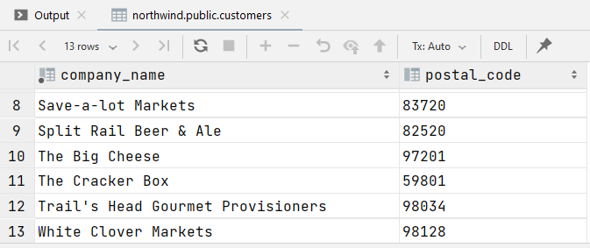
SELECT company_name, postal_code
FROM customers where country='USA'

Slide 107
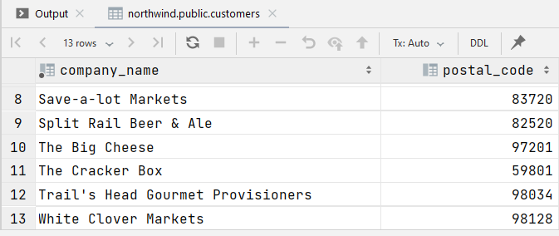
SELECT company_name, CAST(postal_code AS INT)
FROM customers where country='USA'

Slide 108
SELECT company_name, postal_code::INT
FROM customers where country='USA'
professor faculty of medicine

Slide 109
useful Data Manipulation Function
length(column-name-expr) - returns length of string
trim(column-name-expr) - removes leading and trailing spaces
strpos(column-name-expr, string) - returns position of string in expression
substr(column-name-expr, position, length) - returns length characters from string, starting search from given character position; first character is counted as position 1
round(column-name-expr, length) - rounds number to given number of decimal places
abs(number) - gets the absolute value of number

Slide 110
some useful “magic” PreDefined Variables
CURRENT_DATE
CURRENT_TIME
CURRENT_TIMESTAMP
CURRENT_USER

Slide 111
CREATE TABLE
CREATE [TEMPORARY] TABLE table-name (
{ column-name type [ column-constraint ] [,...] }
[ CONSTRAINT table-constraint ]
) [ INHERITS (existing-table-name) ]

Slide 112
column-constraint
NOT NULL - column cannot have NULL value stored in it
UNIQUE - value stored in column must be different for each row in database
PRIMARY KEY - effectively, combination of NOT NULL and UNIQUE; each table have only single column marked PK
  if need to create composite primary key must use table- level constraint, rather than column-level constraint
DEFAULT default-value - provide default value when inserting data
CHECK (condition) - check condition when inserting or updating data
REFERENCES - constrains value to be one that appears in column in a separate table

Slide 113
CREATE TABLE example
CREATE TABLE categories2 (
category_id INTEGER PRIMARY KEY,
category_name VARCHAR(50) UNIQUE NOT NULL,
description TEXT,
picture BYTEA
);
INSERT INTO categories2
SELECT * FROM categories

Slide 114
Table Constraints
UNIQUE(column-list) - value stored in columns listed must be different from that stored in all other rows of this column-list of table
PRIMARY KEY(column-list) - effectively combination of NOT NULL and UNIQUE; each table may have only a single PRIMARY KEY constraint, either as table constraint or as column constraint
can refer to more than one column
listed after all columns in CREATE TABLE

Slide 115
Row Constraint
CHECK (condition) - allows to check condition when inserting or updating data

Slide 116
Multi Table Constraint
REFERENCES - constrains value to be one that appears in column in separate table

Slide 117
ALTER TABLE structure
create new working table with identical structure to existing table
use INSERT INTO to populate working table with data identical to original table
drop (delete) existing table
re-create table with same name, but with changes
use INSERT INTO again to populate altered table from working table
delete working table

Slide 118
DROP TABLE

Slide 119
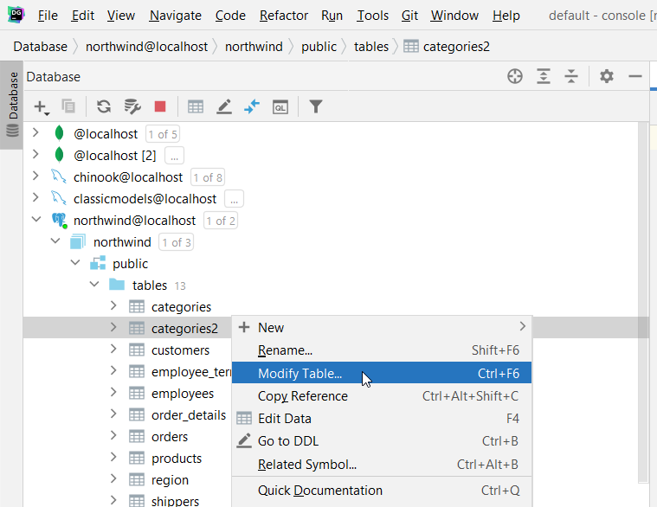

Slide 120
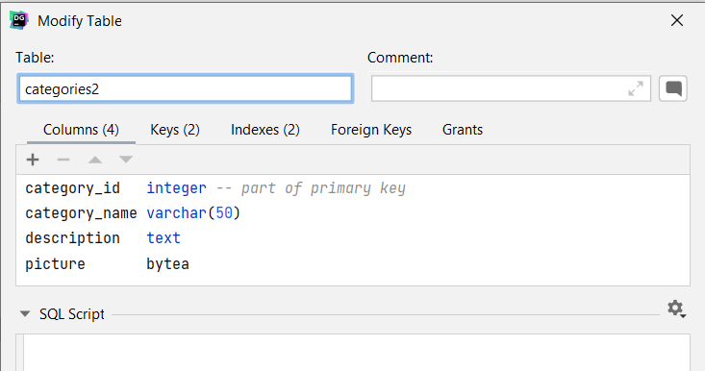

Slide 121
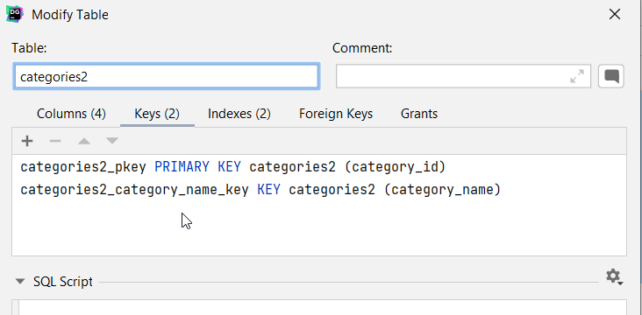
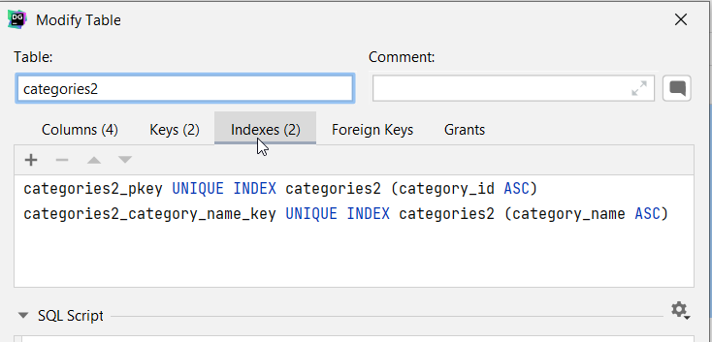

Slide 122
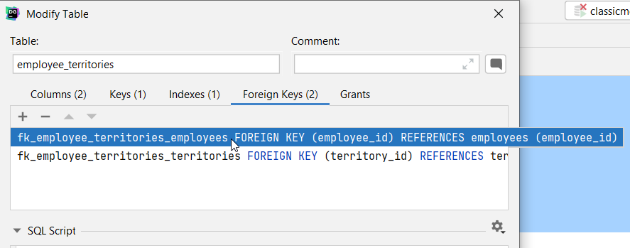

Slide 123
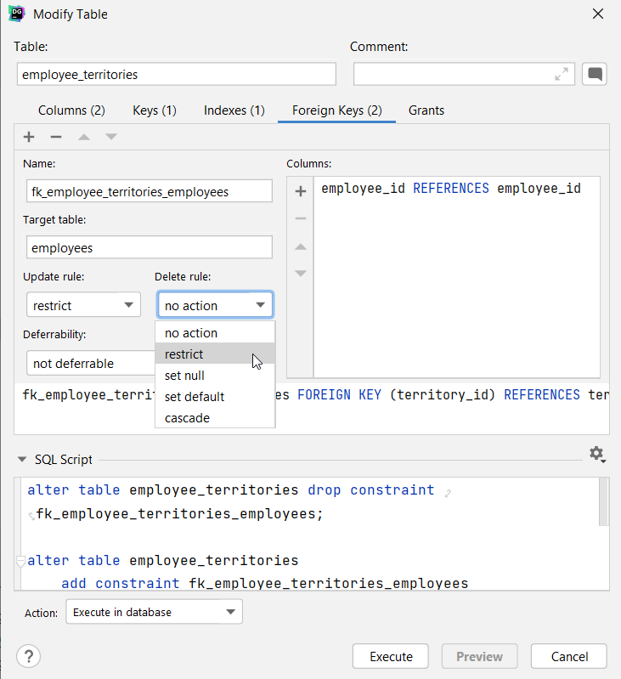

Slide 124
Foreign Key as
Column Constraint / Table Constraint
[CONSTRAINT arbitrary-name] existing-column-name type
REFERENCES
foreign-table-name(column-in-foreign-table)
/
CONSTRAINT [arbitrary-name] FOREIGN KEY (column-list)
REFERENCES
foreign-table-name(column-list-in-foreign-table)

Slide 125
ON UPDATE and ON DELETE
specify rules in Foreign Key constraint about how to handle violation in two circumstances: UPDATE and DELETE operations
could CASCADE change from table with primary key
could SET NULL to make column NULL, since it no longer references primary table

Slide 126
ALTER TABLE orders
ADD CONSTRAINT fk_orders_customers
Foreign Key (customer_id) REFERENCES customers
ON UPDATE CASCADE;
example tells PostgreSQL that if we delete row in customers with customer_id that is being used in orders table, it should automatically delete related rows in orders
might be what we intended, but it is normally dangerous choice; usually much better to ensure applications delete rows in correct order, make sure there are no orders for customer before deleting customer entry

Slide 127
usually applicable for Weak entities …

Slide 128
CREATE VIEW name-of-view
AS select-statement;

Slide 130
Samples
Many database systems provide sample databases with the product. A good intro to popular ones that include discussion of samples available could be found on Sample Databases - PostgreSQL wiki https://wiki.postgresql.org/wiki/Sample_Databases

Slide 131
Wikiversity https://www.wikiversity.org/ is a Wikimedia Foundation project that supports learning communities, their learning materials, and resulting activities. If search there for database examples the first result will be northwind Database Examples/Northwind - Wikiversity
https://en.wikiversity.org/wiki/Database_Examples/Northwind.

Slide 132
Northwind database for Postgres could be found at https://github.com/pthom/northwind_psql.

Slide 133
Exercise (NorthWind)
Study at least one example sample database. Make some CRUD operations:
At least ten INSERT.
At least twenty SELECT queries.
At least ten UPDATE.
At least nine DELETE.

Slide 134
Exercise (NorthWind)
Add a new table countries to the northwind sample database and prepare to latter change the country field from customers into a foreign key reference.

Slide 135
Exercise (NorthWind)
Get all Customers alphabetically, by Country and name
Get all Orders by date
Get the count of all Orders made during 1997
Get the names of all the contact persons where the person is a manager, alphabetically
Get all orders placed on the 19th of May, 1997
Create a report for all the orders of 1996 and their Customers (152 rows)

Slide 136
Exercise (NorthWind)
Shows the number of employees and customers from each city that has employees in it (5 rows)
Shows the number of employees and customers from each city that has customers in it (69 rows)
Shows the number of employees and customers from each city (71 rows)
Create a report that shows the order ids and the associated employee names for orders that shipped after the required date (37 rows)

Slide 137
Exercise (NorthWind)
Create a report that shows the total quantity of products (from the Order_Details table) ordered. Only show records for products for which the quantity ordered is fewer than 200 (5 rows)
Create a report that shows the total number of orders by Customer since December 31, 1996. The report should only return rows for which the total number of orders is greater than 15 (5 rows)

Slide 138
Exercise (NorthWind)
Insert yourself into the Employees table
Insert an order and details for yourself in the Orders table and in the Order_Details table
Update the phone of yourself (from the previous entry in Employees table) (1 row)
Double the quantity of the order details records you inserted before
Delete some records you inserted before.

Slide 139
Exercise (NorthWind)
What were our total revenues in 1997 (Result must be 617.085,27)
What is the total amount each customer has paid us so far (Hint: QUICK-Stop has payed us 110.277,32)
Find the 10 top selling products (Hint: Top selling product is "Côte de Blaye")
Create a report with total revenues per customer
Which UK Customers have payed us more than 1000 dollars (6 rows)
How much has each customer paid in total and how much in 1997

